Slide 1

Understanding user sentiments by observing their software usage pattern
By
Manish Singh, 2017HT12447
BIRLA INSTITUTE OF TECHNOLOGY & SCIENCE – PILANI
April 2019

Slide 2
Acknowledgment
I would like to acknowledge and express my gratitude to Adobe Systems for giving me this opportunity to participate in the M.Tech program for Software Systems of BITS and providing all support as needed.
I would also like to express my sincere gratitude to my advisor Dr. Mohit Mahajan for guiding me in this work and providing his valuable input from time to time and encouraging me to take up this topic
I want to place my gratitude to BITS faculty and administration for providing full support whenever required.
Last but not the least, I would like to thank my family for their continuous support while I was working on this project.

Slide 3
Agenda
Introduction
Approach
UI and Building the agent into the application
Processing RAW user usage data to determine user experience
Backend Storage
Calculating customer sentiment score
Integrating the system
Conclusion and future work

Slide 4
Introduction

Slide 5
Introduction
Adobe is the market leader in digital media and digital marketing products
Well known products from Adobe are Photoshop, Illustrator
Adobe invests heavily in customer experience. It wants it’s customers to be successful.
Adobe reaches out to it’s customers via various mediums like symposiums, summits. It has also employed account managers, technical account managers who advocate for the customer.
Monitors the support channels, social media channels to understand what the customer is saying. It also tries to understand the sentiments of the customer.
Sends periodic surveys, measures KPI of its customer care team to ensure that the customer is always happy.

Slide 6
Problem
All methods used to determine the sentiment of the customer works after the customer reaches out to Adobe
The company wants to detect the customer sentiment while they are using the product itself
This will help the company as it can instantly suggest some help articles to the user in case they are facing any issue using the product and monitor the customer sentiments by calculating a score almost in real time.
This will place the company in a very advantageous position as it can prevent a user having a bad user experience well in advance.
This can also mean increased business for the company and an overall happy Adobe community.

Slide 7
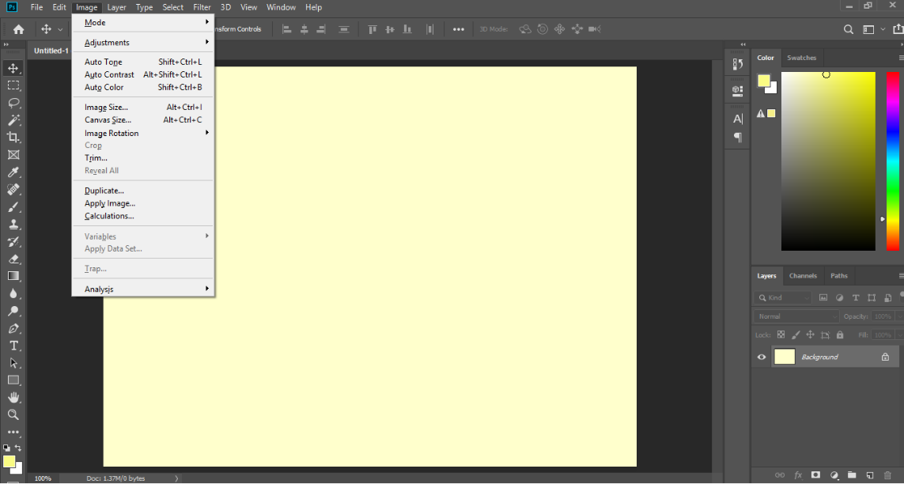
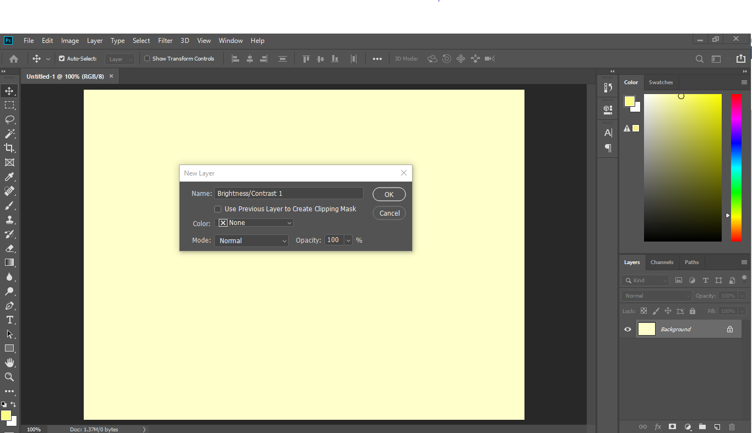
Adobe UI
Adobe has standardized it’s UI for its product. It is primary based on a menu and dialog system
All the available operations are present in a menu system
Based on the option a user selects, a dialog gets open and on pressing OK, the operation is applied
Menu system in Photoshop
Dialog box for completing action in Photoshop

Slide 8
Solving the problem
Adobe has standardized its UI for all of its products
A user will primary interact with the application using menus and dialog boxes.
This will primary drive the user experience for a given user. We can look at whether the outcome of the intended operation is successful or not, how much time did the application take to complete the operation, did the user face any difficulties finding the operation on the menu system
If we could understand the user behavior based on how the user is using the software and how the outcomes are, we can categorize the user sentiments and can help the user even before they approach Adobe

Slide 9
Approach

Slide 10
What to look for
What is the proficiency of the user using our product i.e. a user can just be a beginner, who has very limited to no knowledge on how to use our product, all the way up to a professional user.
How the user is selecting the options for the operation they want to perform on the menu system i.e. path travelled by the mouse. As we use menus a lot, it is very important for us to understand this aspect.
What was the outcome of the operation. Did it fail or succeed?
How much time did the operation take to complete i.e. did an operation take more time than what it should take.

Slide 11
Understanding the user
We can classify a user into 3 categories: Beginner, Intermediate, Professional
Beginner: This type of user is the one who is starting out with the product or has very limited knowledge of the product. This type of user needs the maximum handholding as they are likely to feel negative about the product during the initial phases.
Intermediate: : This type of user is the one who has gained some knowledge using the product. They are aware of the majority of the features and can understand the product terminology. However, they are still learning and may not be aware of the best practices
Professional: This type of user knows the in and out of the product. They are the people whom other users look up to for help or to do complex tasks.

Slide 12
Understanding the customer
We can classify a customer into 2 categories: Individual and Enterprise
Individual: This type of customer are individual users who purchase the product directly and use it for themselves.
Enterprise: This type of customer generally range from small teams to big enterprises and have multiple users.

Slide 13
Impact on sentiment score
While calculating the customer sentiment score we give different weightage to each user level
Professional users have a higher weightage
Intermediate users also have a higher weightage but not equal to professional users
Beginners have a lower weightage but can help in identifying areas of training

Slide 14
Features to be monitored
To calculate the customers sentiment score and to recommend appropriate help documents we have to monitor the following features
The way the user reaches the intended option in the menu system
The time the application takes to complete the operation
The outcome of the operation of the intended action
If we monitor these three key parameters, we can capture enough data around them which can help us understand the customer’s sentiment while using the product

Slide 15
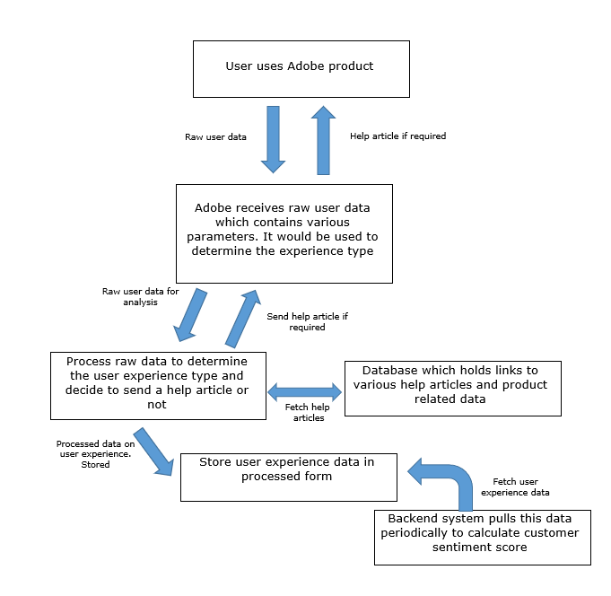
How it works

Slide 16
UI and Building the agent into
the application

Slide 17
UI
For this project, a UI is built using HTML, JavaScript and CSS
UI replicates Adobe’s UI standard of:
menu based system for navigation
dialog boxes for operation
UI provides 39 operations

Slide 18
Agent
Agent is built in JavaScript and is built inside the UI
Agents monitors the following:
Capture the pointing device path from start to end when selecting any operation
The selected operation
User experience level
End operation status
Time taken for the operation to complete
Company Name

Slide 19
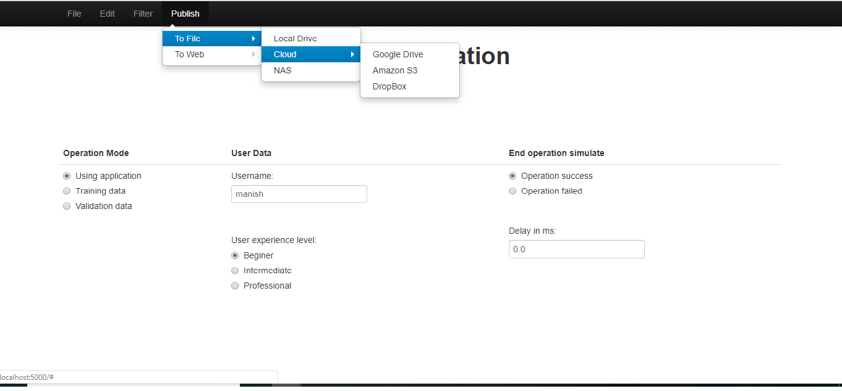
UI Screenshots

Slide 20
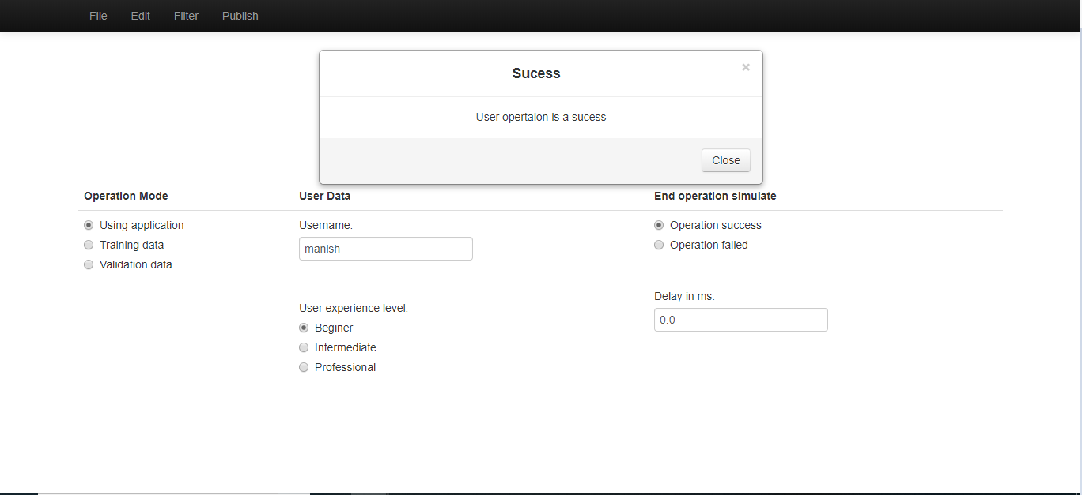
UI Screenshots

Slide 21
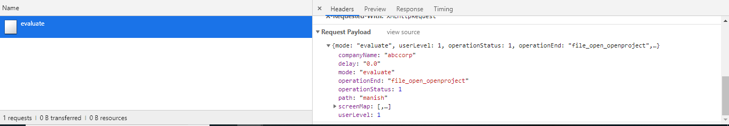
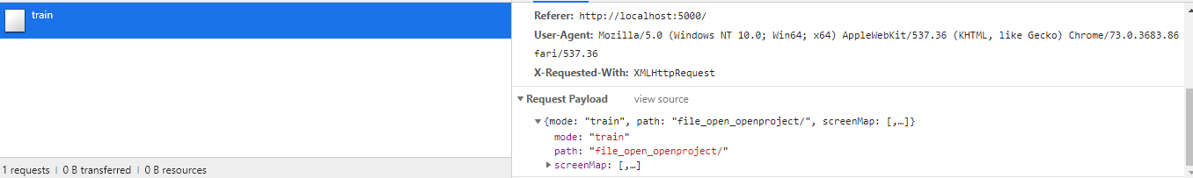
Agent sending data

Slide 22
Processing RAW user usage data to
determine user experience

Slide 23
Defining experience
Once the agent sends in the raw data we have to process it to determine the user experience on the features we are monitoring. We are monitoring the following features to determine the customer sentiment:
The path the user took to select an operation
The outcome of the selected operation
The time it took to complete the operation
We would need to calculate the user experience as +1 for good and -1 for bad on these features individually for each user.

Slide 24
Determining the path a user took
When we have to analyze what path the user took to reach the desired operation on the menu system, the conventional way is to simply note down the options which were highlighted and monitor the time from start to finish. Thought this method is good it has 2 shortcomings:
It does not record the actual path of the pointing device. Its quite possible that though the user selected the options correctly, the path of the pointing device swayed a lot.
Sometimes a user selected the right options and the right path but due to some external impedances, they leave the mouse in between and return after sometime to complete the action. The traditional method would record this as a delay in reaching out to the desired operation.

Slide 25
Determining the path a user took
If we can train the computer to tell us if the path followed by the user was the optimal one for the given operation, we can very quickly and accurately predict the customer experience.
To achieve this, we design a Convolutional Neural Network (CNN). The idea is to train the network on identifying what a good path would look like for a given operation and then present the usage pattern of the user and ask it to predict which operation did the user opt for. If the prediction matches with what the had user chosen, we categorize it as a good experience else we categorize it as a bad experience.

Slide 26
Convolutional Neural Network
We take the raw data of the path sent by the agent. This is sent as a 2D array with the value of 255 (white) filled in the pixel over which the pointing device traveled and rest have the value as 0 (black). This 2D array is converted to an image and saved.
Based on the training data, we train the CNN on good paths for the given operations. We scale down the images to 300x300
We use 2 layers of convolutions using 16 random filters of size 3x3.
After each convolution we do a maxpooling of 2x2. This helps in down sampling the image
We pass this data to 512 neurons in the hidden layer which feeds 39 neurons on the output layer
For convolution and hidden layer of neurons we use the activation function as ReLU.

Slide 27
Convolutional Neural Network
For the output layer, we use the activation function as softmax
For our CNN, we use Adam optimizer algorithm
For loss calculation we use categorical crossentropy as we have multiple classes
We use 15 epochs with 28 steps per epoch for training and terminate the training when we get 90% accuracy
Our CNN is written using Tensorflow

Slide 28
Convolutional Neural Network
model.compile(optimizer='adam',
loss='categorical_crossentropy',
metrics=['accuracy'])
model = tf.keras.models.Sequential([
tf.keras.layers.Conv2D(16, (3,3), activation='relu', input_shape=(300, 300, 1)),
tf.keras.layers.MaxPooling2D(2, 2),
tf.keras.layers.Conv2D(16, (3,3), activation='relu'),
tf.keras.layers.MaxPooling2D(2,2),
tf.keras.layers.Flatten(),
tf.keras.layers.Dense(512, activation='relu'),
tf.keras.layers.Dense(train_generator.num_classes, activation='softmax')
])
history = model.fit_generator(
train_generator,
steps_per_epoch=28,
epochs=15,
validation_data = validation_generator,
validation_steps=28,
callbacks=[callbacks])

Slide 29
Analysing the path
We save the trained model
When a new pointing device path comes, we analyze it using our CNN.
If the CNN predicts the paths belonging to the operation the user selected, we count as good experience and give it a +1 else we give it a -1

Slide 30
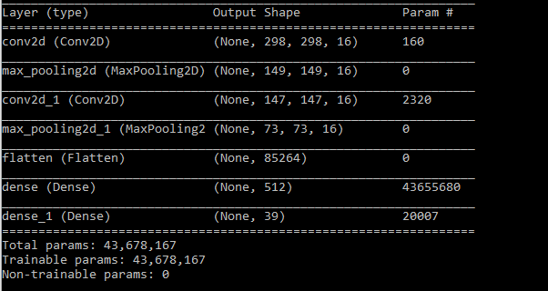
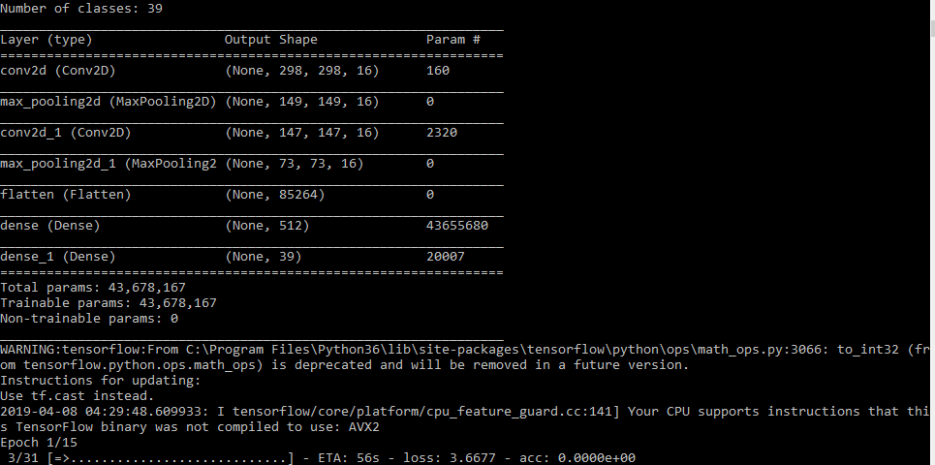
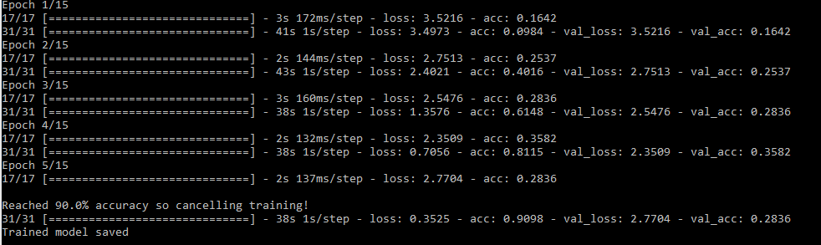
Model

Slide 31

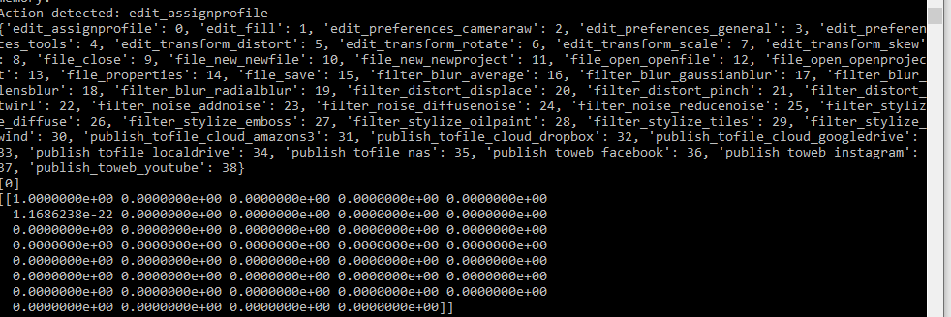
Analysing the path

Slide 32
Determining the outcome and operation time
If the outcome of an operation is failure, we give it a bad experience -1. If it is a success, we give it a good experience +1
Similarly, if an operation took more time than expected, we give it a -1 (bad experience), else we give it a +1 (good experience)
If the user has a bad experience navigating the menus or their operation fails, we suggest some help articles back to the user in real-time.

Slide 33
Backend Storage

Slide 34
Storing product information
We use MongoDB to store all the information
For all application specific data, we store information in Product DB
This DB has 2 collections:
features: Features contain the list of operations the UI has
helpdocs: Helpdocs contain the list of help articles for each operation the application supports

Slide 35
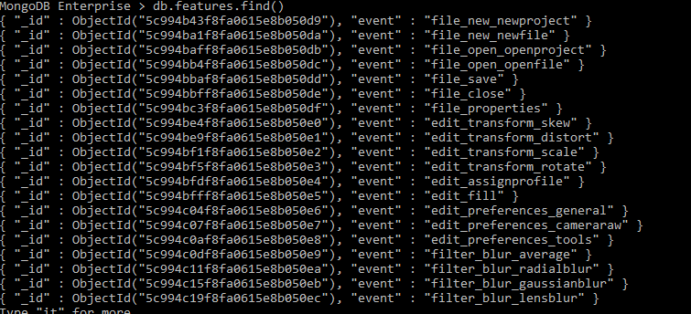
Schema for features collection
Field name | Description
_id | Unique key for the record
event | Stores the operation name

Slide 36
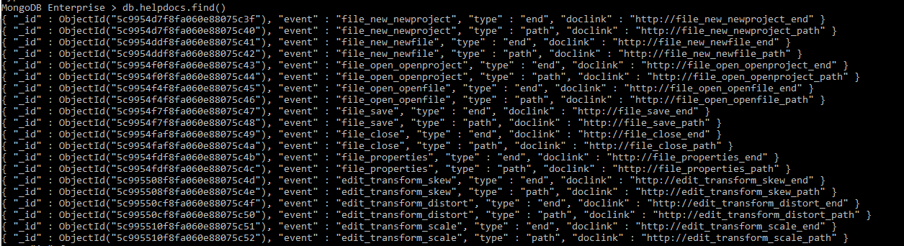
Schema for helpdocs collection
Field name | Description
_id | Unique key for the record
event | Stores the operation name
type | Feature we monitor like path, end operation
doclink | The URL for the help article

Slide 37
Storing customer information
We use MongoDB to store all the information
For all customer specific data, we store information in DB named after customer
This DB has 3 collections:
users: The user collection will hold all the username used by the customer
usage: The usage collection holds all the user experience data for a given customer
overallscore: This collection contains all the calculated score which depict the customer sentiment score

Slide 38
Schema for user collection
Field name | Description
_id | Unique key for the record
User | Username of the user

Slide 39
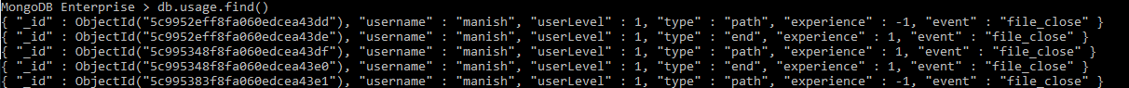
Schema for usage collection
Field name | Description
_id | Unique key for the record
event | Stores the operation name
type | Feature we monitor like path, end operation
experience | +1 for good and -1 for bad
userLevel | The level of the user. 1 for beginner, 2 for intermediate and 3 for professional
username | Username of the user

Slide 40
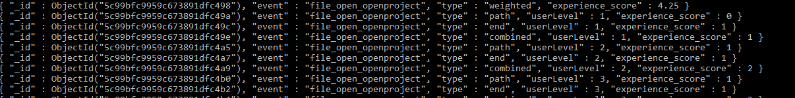
Schema for overallscore collection
Field name | Description
_id | Unique key for the record
event | Stores the operation name
type | Feature we monitor like path, end operation
experience_score | Experience score of the feature
userLevel | The level of the user. 1 for beginner, 2 for intermediate and 3 for professional

Slide 41
Calculating customer sentiment score

Slide 42
Calculating the customer sentiment score
To calculate the user sentiment score, we need to analyze the data inside the usage collection.
The methodology applied to calculate the customer sentiment score is as follows:
Calculate the score of each operation, feature wise, individually for each user level
Multiply the weights for each feature of the operation, user level wise, with the score calculated previously for the feature
Add the calculated weighted score to get the operation score.
Add all the operation scores to get the customer sentiment score

Slide 43
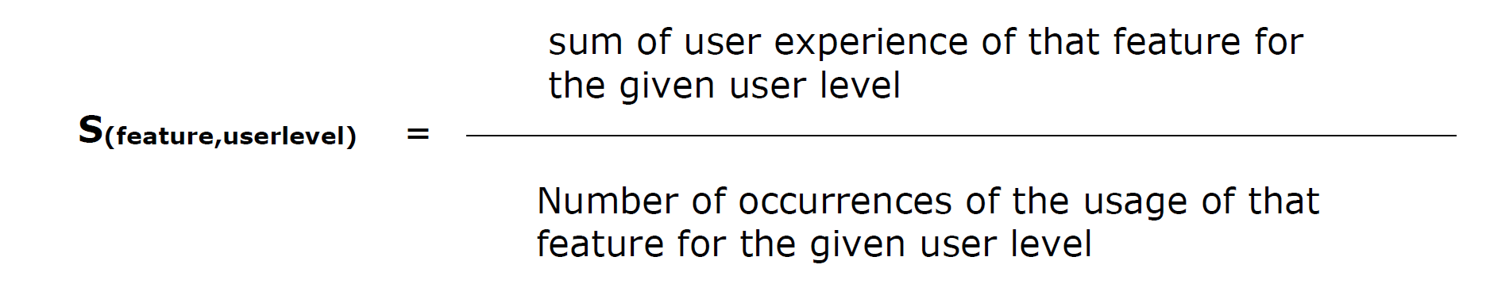
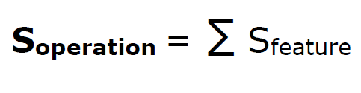
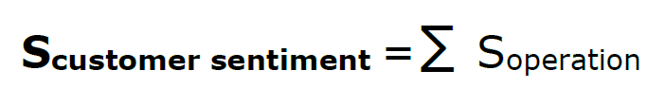
Mathematical representation

Slide 44
Mapping score to sentiment
Score | Customer Sentiment
Above 1.0 | Extremely Happy
Between 0.7 to 1.0 | Happy
Between -0.7 to 0.7 | Neutral
Between –1.0 to -0.7 | Disappointed
Below -1.0 | Sad

Slide 45
Integrating the system

Slide 46
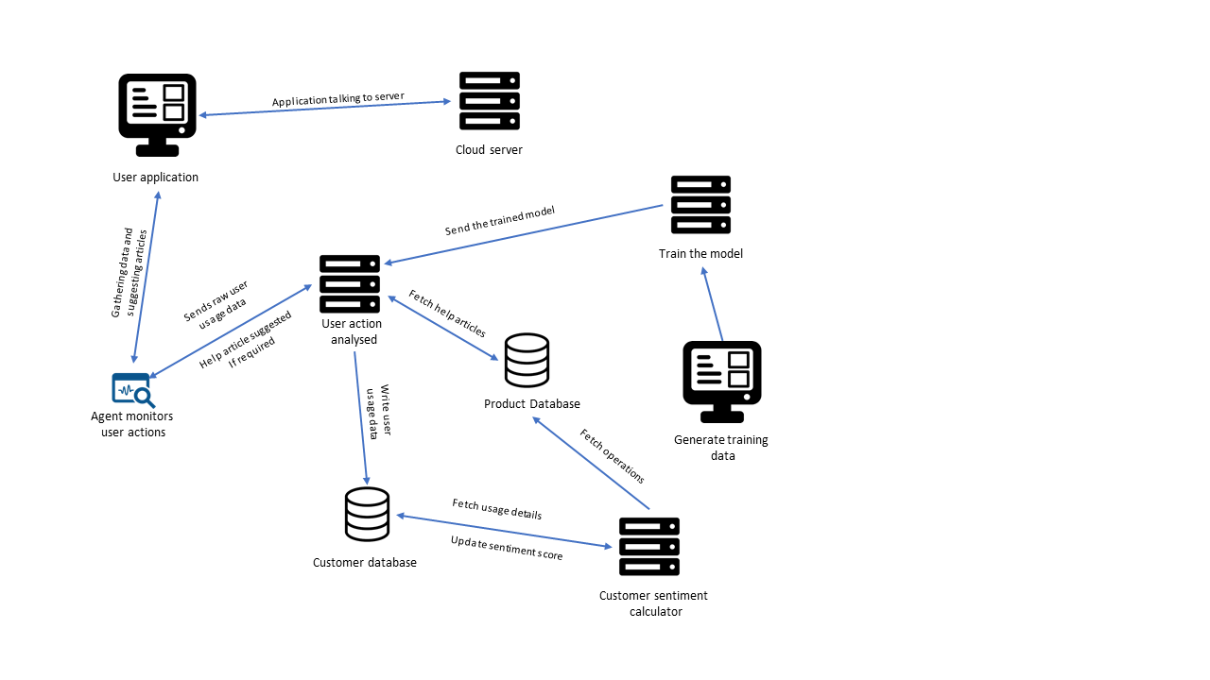
System flow diagram

Slide 47
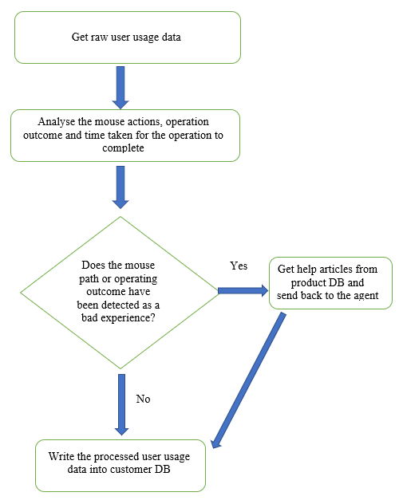
Flow diagram for the server which analyses the user actions

Slide 48
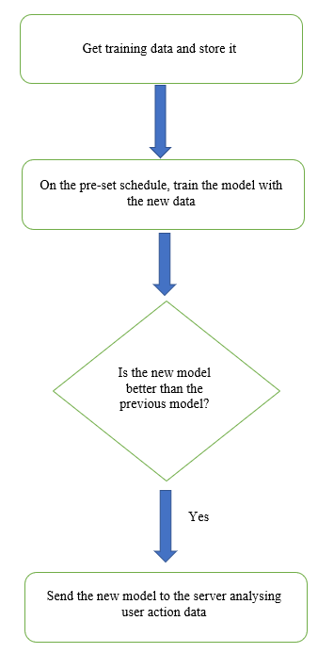
Flow diagram of training server

Slide 49
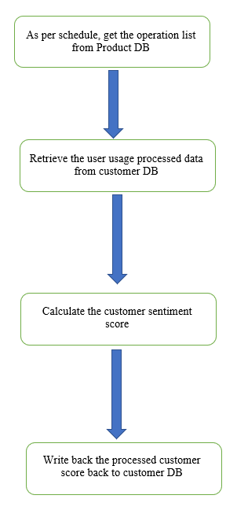
Flow diagram of report generator

Slide 50
Conclusion and future work

Slide 51
Conclusion
In this project, we have designed a system which can capture a user’s application usage data over multiple aspects and can analyze them in real-time. Based on the real-time analysis, we can recommend the user some help articles if they are facing difficulties using the application. We can also calculate the customer sentiment score and can take affirmative actions well in advance.
This approach can be applied to any product Adobe has. As we use Machine learning and Artificial intelligence, we can train the model to recognize patterns for each application individually thus making it easily portable to any of the products.
The amount of data we now gather about the user helps us in making more informed decisions and we can make our customers more successful in what they are doing.

Slide 52
Future Work
In this project, we have taken 39 operations and monitor the usage on 3 parameters. We can further add more features to monitor like the user usage data of the same application on different devices, how the application is rendered, what values the user inputs for a given operation etc. We can also cover more UI types like Mobile interfaces.
For the features where we are using some pre-determined data like weights applied to calculate feature score or measuring the time the application takes to complete an operation against a predefined list. We can further use machine learning to come up with a more accurate value to compare with.

Slide 53
Bibliography and References
BOOKS
Andreas C. Muller & Sarah Guidol, Introduction to Machine Learning with Python, Sebastopol, O’Reilly, 2016
Stuart J. Russell and Peter Norvig, Artifical Intelligence: A modern Approach, Essex, Pearson, 2014
Tom Hope, Itay Lieder and Yehezkel S. Resheff, Learning TensorFlow: A Guide to Building Deep Learning Systems, Sebastopol, O’Reilly, 2017

Slide 54
Bibliography and References
CONFERENCE PROCEEDINGS
Bin Lin, Fiorella Zampetti, Gabriele Bavota, Massimiliano Di Penta, Michele Lanza, Rocco Olivet; Sentiment analysis for software engineering: how far can we go?; ICSE '18 Proceedings of the 40th International Conference on Software Engineering; Gothenburg, Sweden — May 27 - June 03, 2018; ACM New York, NY, USA
D.P. Kingma, J. Ba, Jimmy Lei Ba; Adam: A Method for Stochastic Optimization, ICLR, San Diego, 2015
Xavier Glorot, Antoine Bordes, Y. Bengio; Deep Sparse Rectifier Neural Networks; 14th International Conference on Artificial Intelligence and Statistics (AISTATS), April 11-13, 2011, Ft. Lauderdale, FL, USA
Kevin Jarrett, Koray Kavukcuoglu, Marc'Aurelio Ranzato, Yann Lecun; What is the Best Multi-Stage Architecture for Object Recognition?; International Conference on Computer Vision (ICCV'09); Sep 29, 2009 - Oct 2, 2009; Kyoto, Japan

Slide 55

Thank You

